Slide 1


Gamer cupalovagami
SUMMER CODING CAMP

Slide 2
EXECUTIVE SUMMARY
Gives you anything a gamer/steamers would use and origami for the background and you can connect to other steamers.
SUMMER CODING CAMP

Slide 3
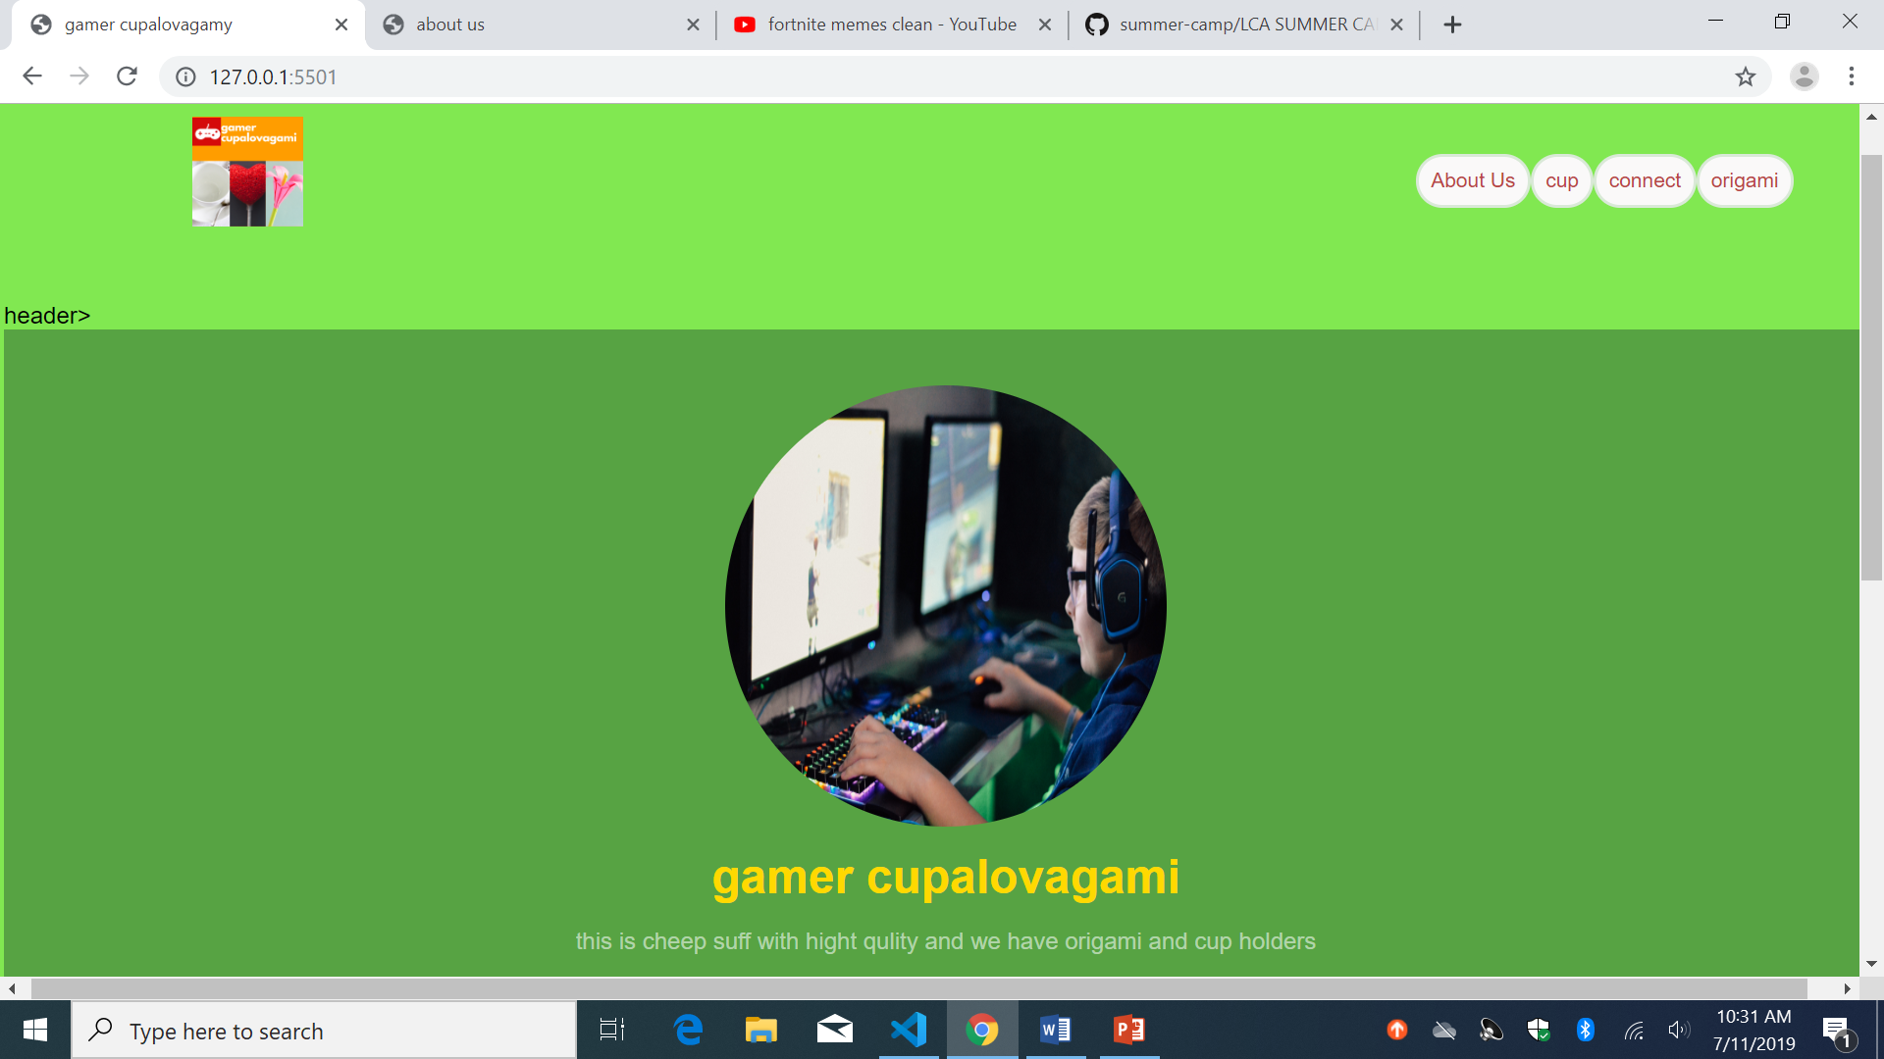
Screenshot of website
SUMMER CODING CAMP

Slide 4
THANK YOU!
SUMMER CODING CAMP

